Slide 1
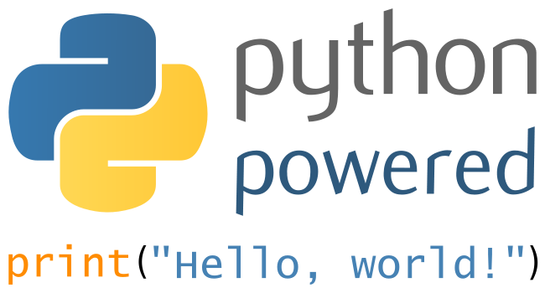
PYTHON PROGRAMMING
Lecture 02 – Programming with Numbers and Strings

Slide 2

GOAL
# In this section we are going to
- declare and initialize variables and constants
- understand integers and floating-point numbers
- importance of comments and good code layout
- arithmetic expressions and assignment statements
- read, process inputs, and display results
- use Python strings
- create simple graphics programs

Slide 3
Contents
Variables
Arithmetic
Input and Output
Problem Solving
Strings

Slide 4
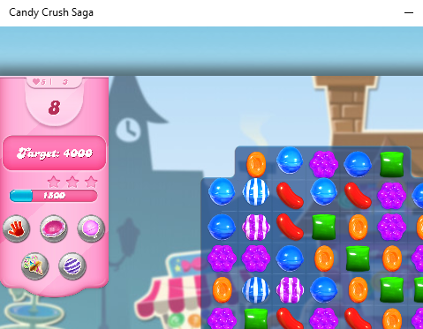
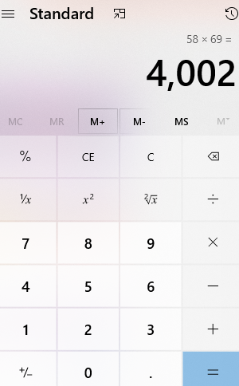
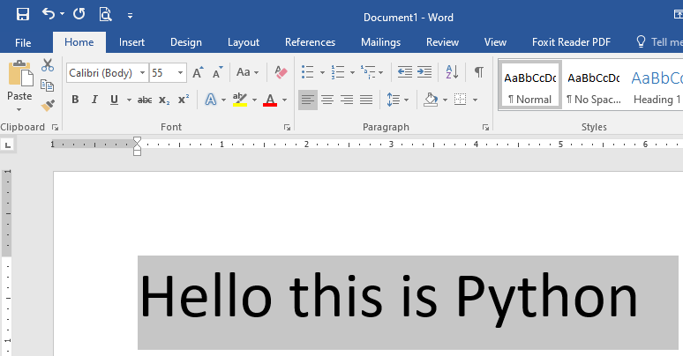
Things your program do
Compute numbers, process text, display graphics

Slide 5
Variables

Slide 6
Variables
Computer programs hold temporary values in the named storage locations
name for easy access
There are many different types of storage to hold different things
You ‘define’ a variable by telling the compiler:
What name you will use to refer it?
What is the initial value to be stored in it.

Slide 7
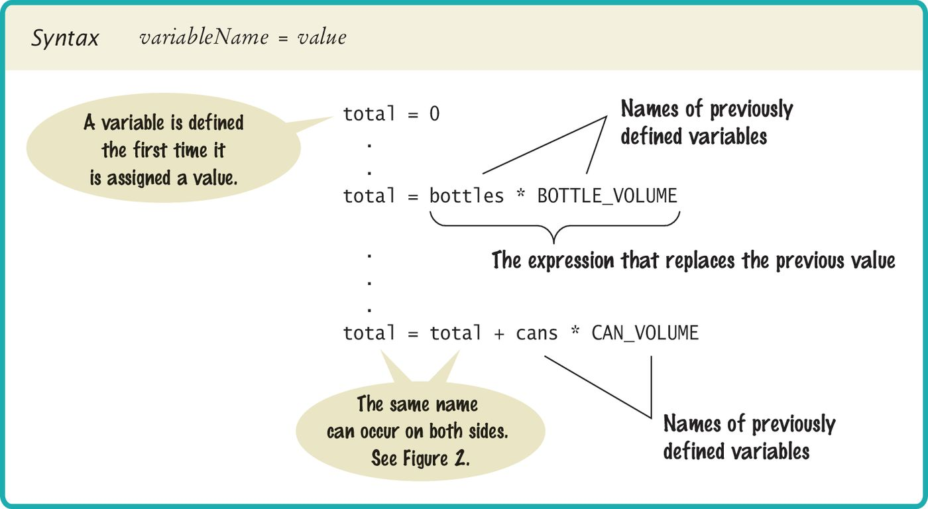
Variable Definition
To define a variable, you must specify an initial value (original).

Slide 8
Variable Definition
Use the ‘assignment statement’ (with an ‘=‘) to place a new value into a variable
cansPerPack = 6 # define & initialize
BEWARE: The ‘=‘ is NOT used for comparison:
It copies the value on the right side into the variable on the left side.
You will learn about the comparison operator in the next chapter.

Slide 9
Assignment Syntax
The value on the right of the ‘=‘ sign is assigned to the variable on the left.

Slide 10
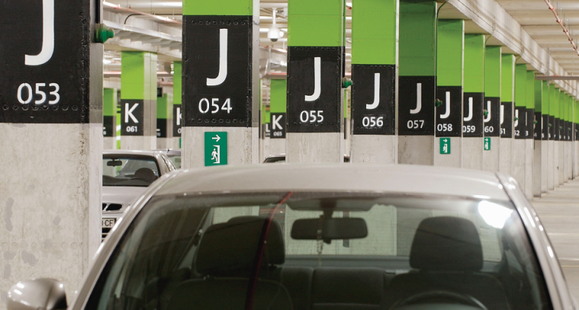
Variables and Contents
Each variable has an identifier (name) and contents
In Python, you must set the contents of a variable when you define it.
cansPerPack = 6
Image a parking space in a parking garage:
Identifier (ID): J053
Contents: Bob’s Chevy
cansPerPack
6
A variable is a storage location with a name!

Slide 11
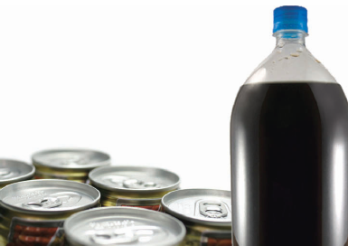
An Example: Soda Deal
Soft drinks are sold in cans and bottles. A store offers a six-pack of 12-ounce cans for the same price as two-liter bottle. Which should you buy? (12-ounce equal approximately 0.355 liters.)
List of Variables | Type of Number
Number of cans per pack | Whole number
Ounces per can | Whole number
Ounces per bottle | Number with fraction

Slide 12
Why Different Types?
There are three different types of data that we will use:-
A whole number (no fractional part) 7 (integer)
A number with a fraction part 8.88 (float)
A sequence of characters ”Bob” (string)
The type of information currently stored by a variable is indicated by whatever to the right of the equals sign.
cansPerPack is an integer
canVolume is a float
cansPerPack = 6
canVolume = 12.0

Slide 13
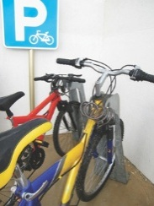
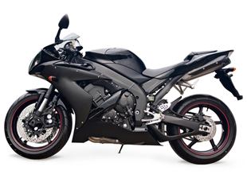
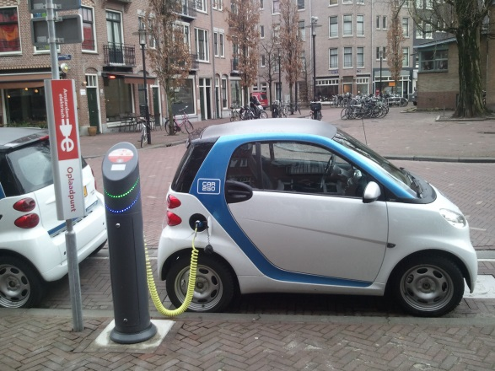
Why Different Types?
Back to the garage analogy, parking spaces may be meant for different types of vehicles
Bicycle
Motorcycle
Full Size
Electric Vehicle

Slide 14
Why Different Types?
Different data represented distinctly
Each data type has different size
Each takes enough size
Makes detecting error easy
Suppose all data type same size
Each takes largest amount
Full size car space for every vehicle
// 7 is whole number store num = 7 // Jhon is name (sequence of characters) name = "Jhon" //Pi is 3.14 a decimal point pi = 3.14
// 7 is whole number store num = 7 // Jhon is name (sequence of characters) name = "Jhon" // subtract num and name result = num - name # Error
num | pi
name
num
pi

Slide 15
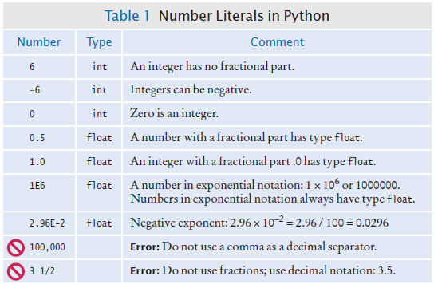
Number Literals in Python
Sometimes when you type a number, the compiler has to ‘guess’ what type it is.

Slide 16
Floating-Point Numbers
Python stores numbers with fractional parts as ‘floating-point’ numbers.
They are stored in 4 parts.
Sign
Mantissa
Radix
Exponent
-5
(×10 ⁰)
Radix ^{exponent}
(-1)
Sign
(5)
Mantissa

Slide 17
Naming Variables
Name should describe the purpose
‘canVolume‘ is better than ‘cv‘
Use these simple rules
Variable names must start with a letter or the underscore (_) character
Continue with letters (uppercase or lowercase), digits or the underscore
You cannot use other symbol (? or % …) and spaces are not permitted
Separate words with ‘camelCase’ notation
Use uppercase letters to signify word boundaries
Don’t use ‘reserved’ Python words

Slide 18
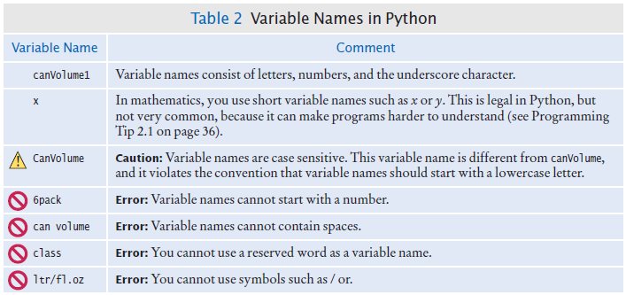
Variable Names in Python
Legal and illegal variable names

Slide 19
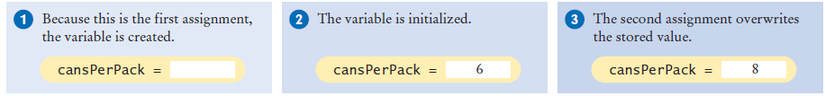
Updating a Variable
If an existing variable is assigned a new value, that value replaces the previous contents of the variable.
For example:
cansPerPack = 6
cansPerPack = 8

Slide 20
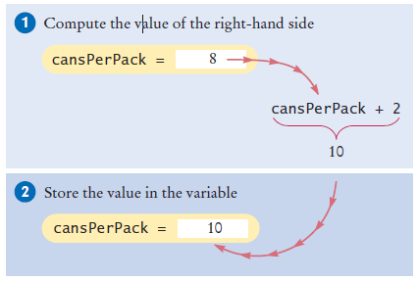
Updating a Variable
Executing the assignment:
Step by step:
Calculate the right hand side of the assignment. Find the value of cansPerPack, and add 2 to it.
Store the result in the variable name on the left side of the assignment operator (in this case, cansPerPack).

Slide 21
Programming Tip: Constants
In Python, it’s a variable whose value should not be changed after it’s assigned an initial value.
BOTTLE_VOLUME = 2.0
It is good style to use named constants to explain numerical values to be used in calculations.
totalVolume = bottles * 2
totalVolume = bottles * BOTTLE_VOLUME
A programmer reading the first statement may not understand the significance of the 2.
Also, if the constant is used in multiple places and needs to be changed, only the initialization changes.

Slide 22
Constants: Naming and Styles
It is customary to use all UPPERCASE letters for constants to distinguish them from variables.
BOTTLE_VOLUME = 2 # constant
MAX_SIZE = 100 # constant
taxRate = 5 # variable

Slide 23
Comments and Error

Slide 24
Python Comments
Use comments at the beginning of each program, and to clarify details of the code.
##
# This program computes the volume (in liters) of a six-packs of soda.
#
Use comments to add explanations for humans who read your code.
*** The compiler ignores comments.

Slide 25
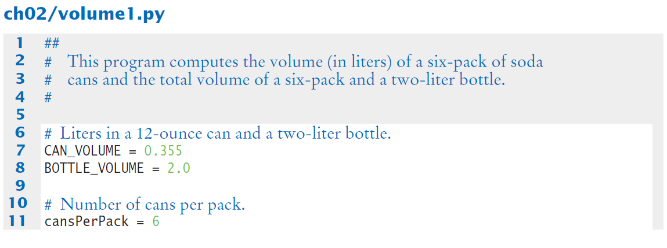
Python Comments Example

Slide 26
Common Error
Undefined variables
You must define a variable before you use it:-
canVolume = 12 * literPerOunce # What is literPerOunce?
literPerOunce = 0.0296

Slide 27
Common Error
Round-off Errors
Floating point values are not exact
price = 4.35
quantity = 100
total = price * quantity
# should be 100 * 4.35 = 435.00
print(total) # print 434.99999999999
You can deal with round-off errors by rounding to the nearest integer or by displaying a fixed number of digits after the decimal operator.

Slide 28
Common Error
Unbalanced Parentheses ()
Consider the expression
((a + b) * t / 2 * (1 – t)
What is wrong with it?
Now consider this expression
(a + b) * t) / (2 * (1 – t)
This expression has three (and three), but it still is not correct

Slide 29
Arithmetic

Slide 30
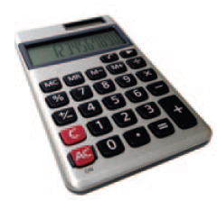

Arithmetic
Python supports all of the same basic math as a calculator:
Addition +
Subtraction -
Multiplication *
Division /
You write your expressions a bit differently …
$$\frac{a+b}{2}$$
(algebra)
(a + b) / 2
(Python)

Slide 31
Arithmetic
Precedence is similar to algebra:
Parenthesis, Exponent, Multiply / Divide, Add / Subtract (PEMDAS)

Slide 32
Mixing Numeric Types
If you mix integer and floating-point values in an arithmetic expression, the result is a floating-point value.
7 + 4.0 # yields the floating value 11.0

Slide 33
Floor Division
When you divide two integers with the / operator, you get a floating-point value. For example,
7 / 4 yields 1.75
We can also perform floor division using the // operator. (It computes the quotient and discards the fractional part, no rounding).
7 // 4 yields 1

Slide 34
Calculating a Remainder
If you are interested in the remainder of dividing two integers, use the % operator (called modulus):
7 % 4 yields 3
Sometimes called modulo divide

Slide 35
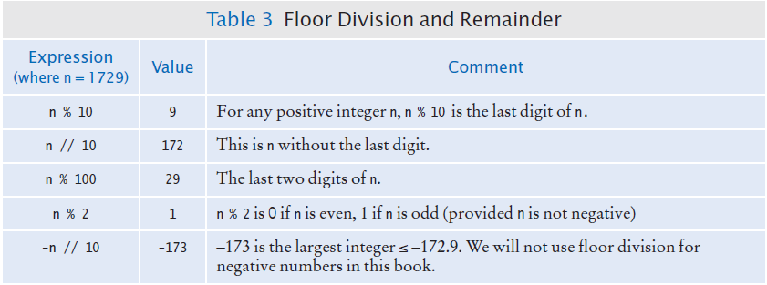
Integer Division and Remainder
Handy to use for making change:
Under CH02
Create → first_arithmetic.py
pennies = 1729
dollars = pennies / 100 # 17
cents = pennies % 100 # 29

Slide 36
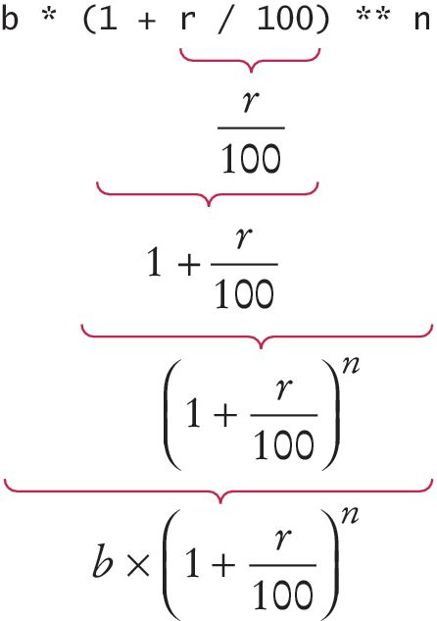
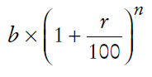
Powers and Roots
In Python, there’s no symbols for power and roots
b * ((1 + r / 100) ** n)
Analyzing the expression:
In Python:
The * is used to calculate product.
The ** are used to calculate an exponent.

Slide 37
Calling functions

Slide 38
Calling Functions
Recall what a function is?
It is collection of programming instructions that carry out a particular task.
The print() function can display information,
but there are many other functions available in Python.

Slide 39
Calling Functions that Return Value
Most functions return a value.
That is, when the function completes its task, it passes a value back to the point where the function was called.
For example:
The call abs(-173) returns the value 173.
The value returned by a function can be stored in a variable:
distance = abs(x)

Slide 40
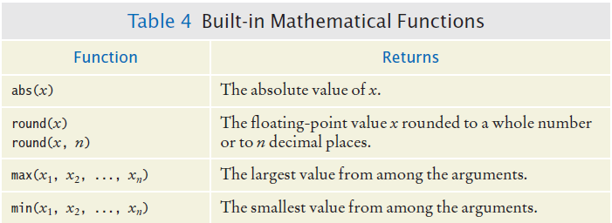
Built in Mathematical Functions

Slide 41
Python Libraries (Modules)
A standard library is a library that is considered part of the language
Must be included with any Python system.
Python’s standard library is organized into modules.
Related functions and data types are grouped into the same module.
Functions defined in a module must be explicitly loaded into your program before they can be used.

Slide 42
Using Functions from the Math Module
For example, to use the sqrt() function, which computes the square root of its argument:
# First include this statement at the top of your program file.
from math import sqrt
# then you can simply call the function as
y = sqrt(x)

Slide 43
Using Variables from the Math Module
Among other things, the math module contains variables for the numbers pi and e
We can access pi using the expression math.pi
import math
print( math.pi ) # 3.14…
print( math.e ) # 2.718..

Slide 44
Using Variables from the Math Module
We can use math.pi in some calculations
import math
# radius is 5
circumference = 2 * math.pi * 5

Slide 45
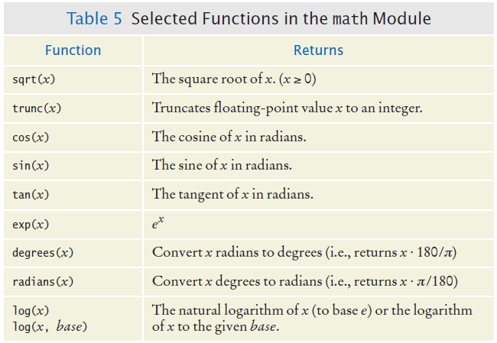
Using Functions from the Math Module

Slide 46
Floating-point to Integer Conversion
You can use the function: int() and float() to convert between integer and floating point values:
balance = total + tax # balance: float
dollars = int(balance) # dollars: integer
You lose the fractional part of the floating-point value (no rounding occurs).

Slide 47
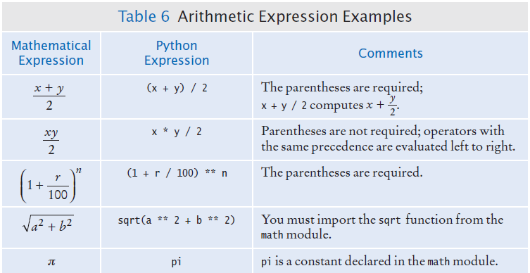
Arithmetic Expressions

Slide 48
String

Slide 49
Strings
In Python, string literals are specify by enclosing a sequence of characters within a matching pair of either single or double quotes.
print(“This is a string.”, ‘So is this.’)
By allowing both types of delimiters, Python makes it easy to include an apostrophe or quotation mark within a string.
message = ‘He said “Hello”’

Slide 50
Strings Length
The number of characters in a string is called the length of the string. (For example, the length of “Harry” is 5).
You can compute the length of a string using Python’s len() function:
length = len(“World!”) # length is 6
A string of length 0 is called the empty string.
It contains no characters and is written as “” or ‘’.

Slide 51
String Concatenation (+)
You can ‘add’ one String onto the end of another
fName = “Harry”
lName = “Morgan”
name = fname + lname # HarryMorgan
You wanted a space in between?
name = fname + “ ” + lname # Harry Morgan
To concatenate a numeric variable to a String:
a = “Agent”
n = 7
bond = a + str(n) # Agent7

Slide 52
String Concatenation (+)
Displaying Strings and numeric inside print():
total = 123
print(“The total is ”, total)

Slide 53
String Repetition (*)
You can also produce a string that is the result of repeating a string multiple times.
Suppose you need to print a dashed line.
Instead of specifying a literal string with 50 dashes, you can use the * operator to create a string that is comprised of the string “-” repeated 50 times.
dashes = “-” * 50
results in the string
“--------------------------------------------------”

Slide 54
Convert Numbers to Strings
Use the str() function to convert between numbers and strings.
Examples:
balance = 888.88
dollars = 888
balanceAsString = str(balance)
dollarsAsString = str(dollars)
Conversely, to turn a string containing a number into a numerical value, use the int() and float() functions:
id = int(“1729”)
price = float(“17.29”)
The conversion is important when the strings come from user input.

Slide 55

Strings and Characters
Strings are sequences of characters
Unicode characters to be exact
Characters have numeric values
See the ASCII code chart
For example, the letter ‘H’ has a value of 72 if it were a number

Slide 56
Copying a Character from a String
Each char inside a String has an index number:
The first char is index zero (0)
The [] operator returns a char at a given index inside a String:
name = “Harry”
start = name[0]
last = name[4]
0 | 1 | 2 | 3 | 4 | 5 | 6 | 7 | 8 | 9
c | h | a | r | s |  | h | e | r | e
0 | 1 | 2 | 3 | 4
H | a | r | r | y

Slide 57
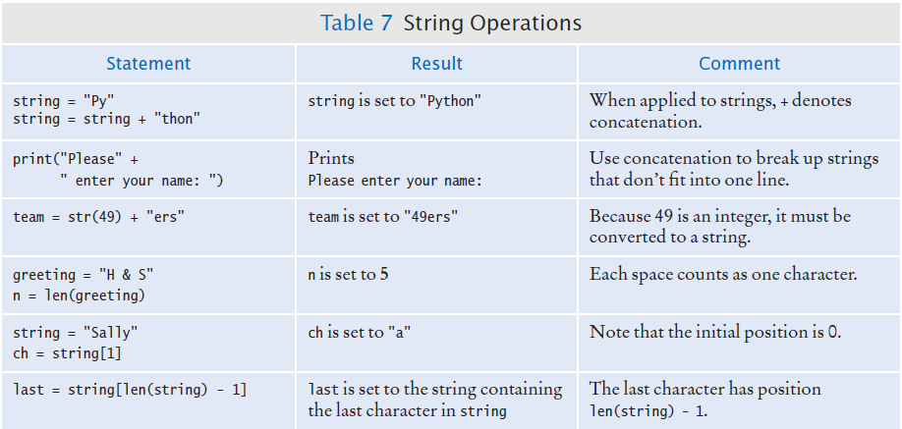
String Operations

Slide 58
Methods
In a computer programming,
An object is a software entity that represents a value with certain behavior.
The value can be simple, such as string, or complex, like a graphical window or data file.
The behavior of an object is given through its methods.
But unlike a function, which is a standalone operation, a method can only be applied to an object of the type for which it was defined.
For example, you can apply the upper() method to any string,
name = “John Smith”
# Sets the uppercaseName = “JOHN SMITH”
uppercaseName = name.upper()

Slide 59
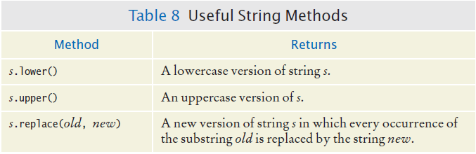
Some Useful String Methods

Slide 60
String Escape Sequences
How would you print a double quote?
print(“He said \“Hello\””) # use \”
Then, how do you print a backslash?
System.out.print(“c:\\Temp\\Secret.txt”)
Special characters inside a Strings
Output a newline with a ‘\n’
Print(“*\n**\n***\n”)
*
**
***

Slide 61
In/out-put

Slide 62
Input and Output
You can read a String from the console with the input() function:
name = input(“Please enter your name”)
Converting a String variable to a number can be used if numeric is needed
(rather than string input)
age = int(input(“Please enter age: ”))
The above is equivalent to doing it two steps
(getting input and then converting it to a number):
aString = input(“Please enter age: ”) # String input
age = int(aString) # converted to int

Slide 63
Formatted Output
Outputting floating point values can look strange:
Price per liter: 1.21997
To control the output appearance of numeric variables, use formatted output tools such as:
print(“Price per liter %.2f” %(price))
Price per liter: 1.22
print(“Price per liter %10.2f %(price))
Price per liter: 1.22
The %10.2f is called a format specifier
2 spaces
10 spaces

Slide 64
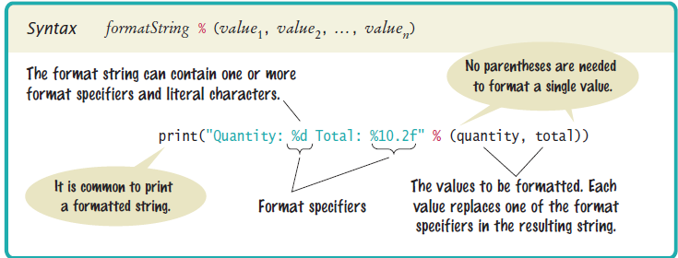
Syntax: Formatting Strings

Slide 65
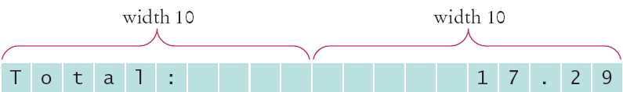
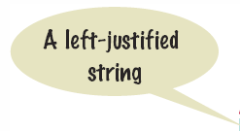

Format Flag Examples
Left justify a String:
print(“%-10s” %(“Total:”))
Right justify a number with two decimal places
print(“%10.2f” %(price))
And you can print multiple values
print(“%-10s%10.2f” %(“Total: ”, price))

Slide 66
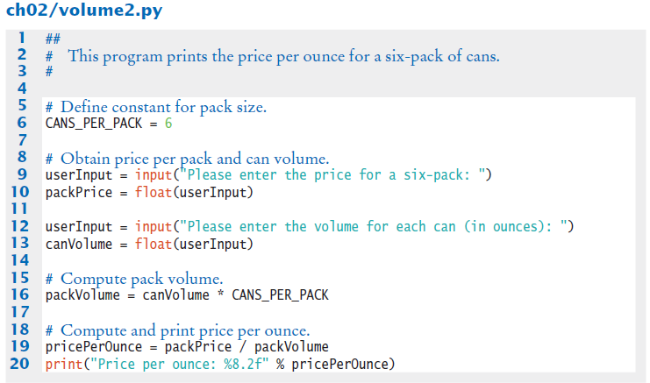
Examples

Slide 67
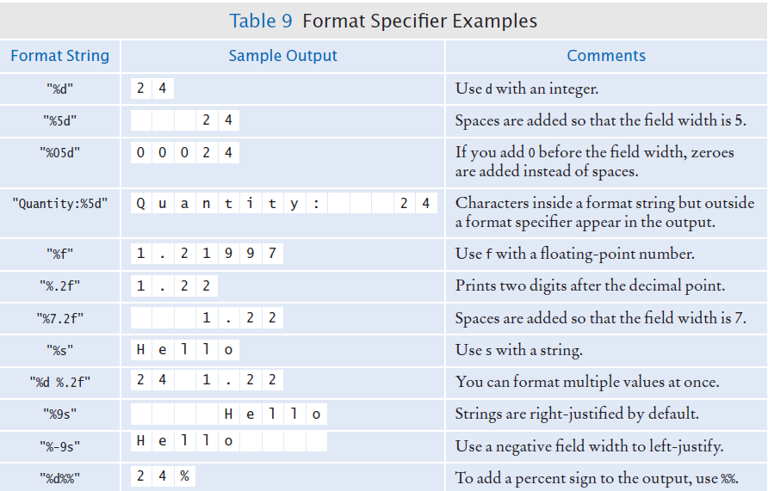
Format Specifier Examples

Slide 68
Programming Assignment

Slide 69
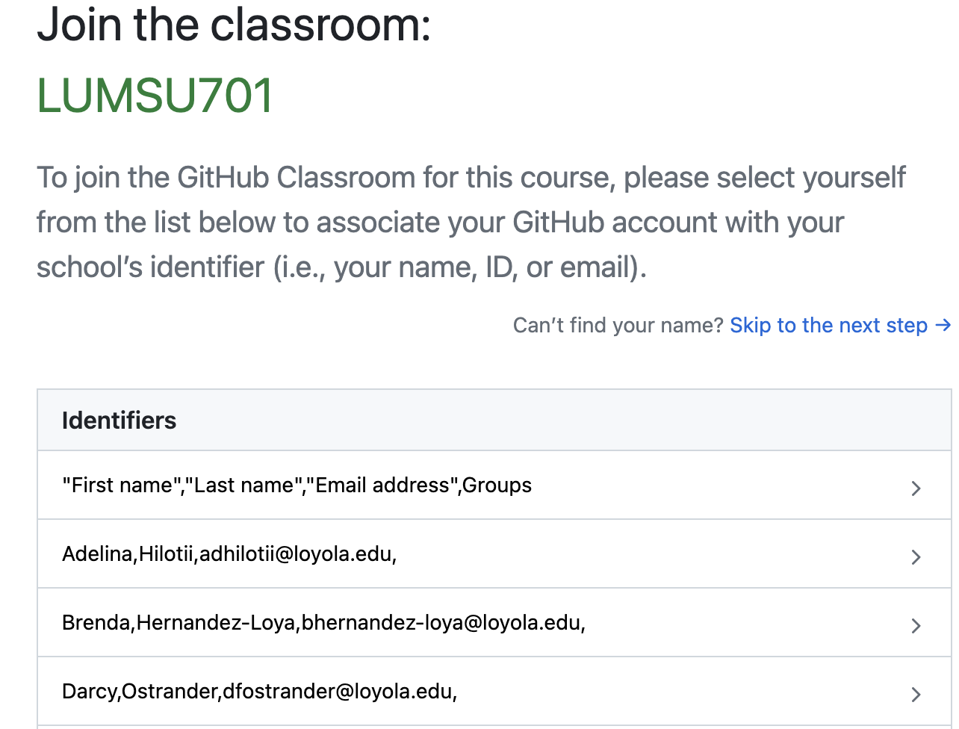
Join the class room

Slide 70
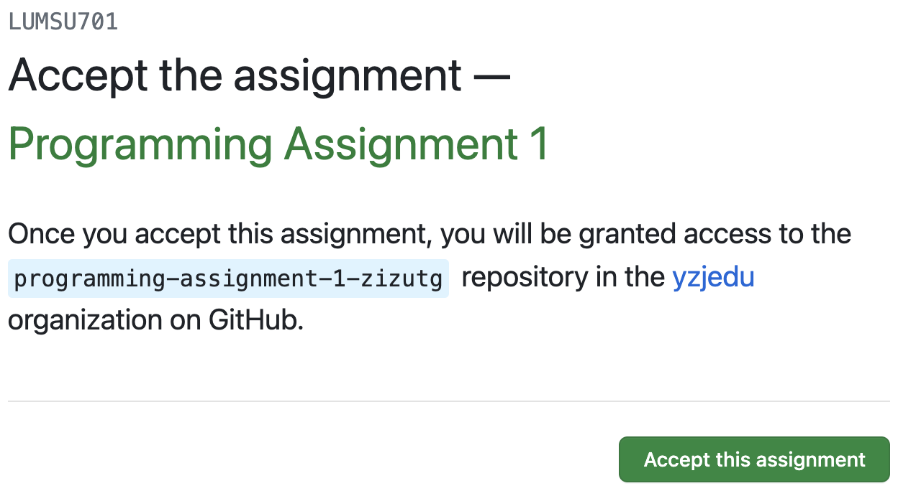
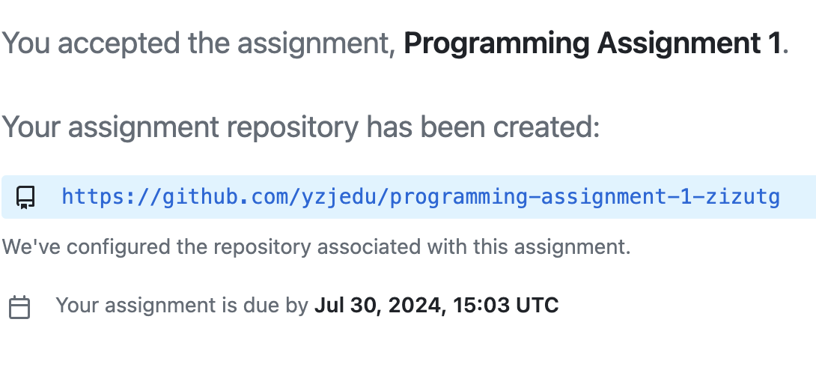
Accept the assignment

Slide 71
Complete the assignment
This will create personal copy of the code
Clone the project
Follow the instructions on the README.md file and the comment on code
Complete the code
Test the program
Push the project to the

Slide 72
Summary: Operators
The assignment operator = does not denote mathematical equality.
Variables whose initial value should not change are typically capitalized by convention.
The / operator performs a division yielding a value that may have a fractional value.
The // operator performs a division, the remainder is discarded.
The % operator computes the remainder of a floor division.

Slide 73
Summary: Variables
A variable is a storage location with a name.
When defining a variable, you must specify an initial value.
By convention, variable names should starts with a lowercase letter.
An assignment statement stores a new value in a variable, replacing the previously stored value.

Slide 74
Summary: Python Overview
The Python library declares many mathematical functions, such as sqrt() and abs().
You can convert between integers, floats, and strings using the respective functions: int(), float(), str().
Python libraries are grouped into modules. Use the import statement to use methods from a module.
Use the input() function to read keyboard input in a console window.
Use the format specifiers to specify how values should be formatted.

Slide 75
Summary: Strings
Strings are sequences of characters.
The len() function yields the number of characters in a String.
Use the + operator to concatenate Strings; that is, to put them together to yield a longer String.
In order to perform a concatenation, the + operator requires both arguments to be strings.
Numbers must be converted to strings using str() function.
String index numbers are counted starting with 0.
Use the [] operator to extract the elements of a String.

Slide 76

END
# Any Questions?

